Slide 1
SEO in 2025: How AI Will Reshape Search and Content Strategy 🔮
pi-datametrics.com

Slide 2
Your webinar hosts
Jon Earnshaw Chief Product Evangelist
Pi Datametrics
Andy Francos Founder
Be Franc, A Marketing Consultancy
Notes:
Andy - I will get you to introduce yourself here

Slide 3
Housekeeping
Questions
Drop any questions in the question pane and we will answer them at the end
Use reactions
Use reactions to quickly and easily participate in the session
On demand
The recording will be sent after the session
Feedback
Send any feedback or requests for future sessions
Notes:
This session should be fun - you can help make it interactive
I’d love to see user reactions
Towards the end we can dive into the platform and look at real data live
Use the Questions Box for any questions or chat or comments or just to say hello

Slide 4
On the agenda:
The biggest AI driven search changes in 2024/5
Predictions for 2025
The latest innovations in Generative AI
Must-have AI tools for 2025
Q&A Session

Slide 5
Poll
To what extent has AI impacted or changed
the way you search for information?
Notes:
To what extent has AI impacted or changed the way you search for information
A. It hasn’t
B. I’m experimenting
C. My search life has changed

Slide 6
1
The biggest AI driven search changes from 2024
Notes:
Lets focus here on the impact of AI on Search technology and search behaviour

Slide 7
Notes:
Lets start with ways of searching Ask Andy - what are your standout AI/Search changes

Slide 8
Notes:
Love it or hate it We have to talk about this
The evolution from SGE to AIO
What does it mean for the SERP?
Let’s look at an example…

Slide 9
Poll
What do you think of today’s AIO?
Notes:
What do you think of today’s AIO
A. I want it gone!
B. It’s better than it was
C. It's the future!

Slide 10
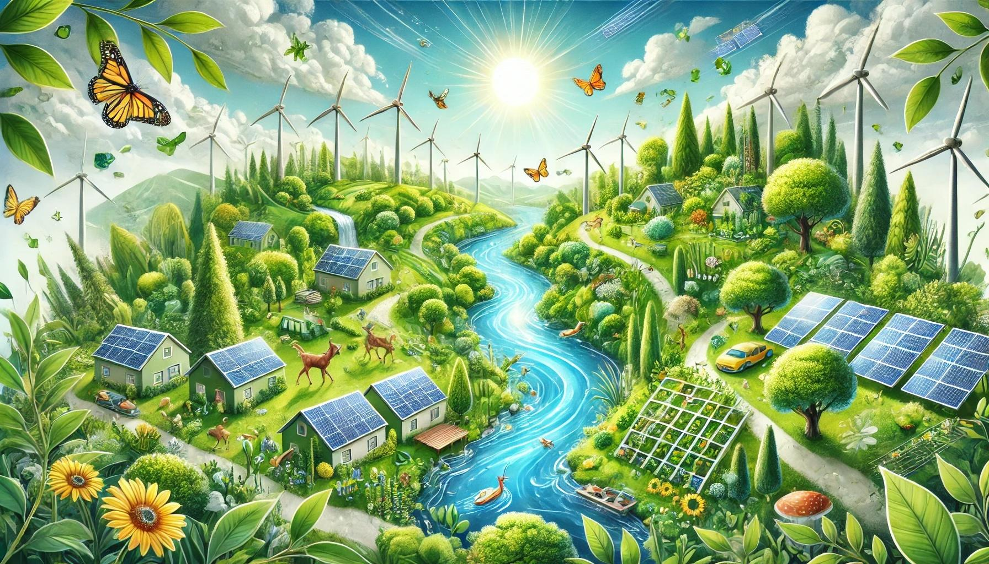
Living sustainably
Notes:
Let’s take this as an example query to show how the SERP has evolved in one year

Slide 11
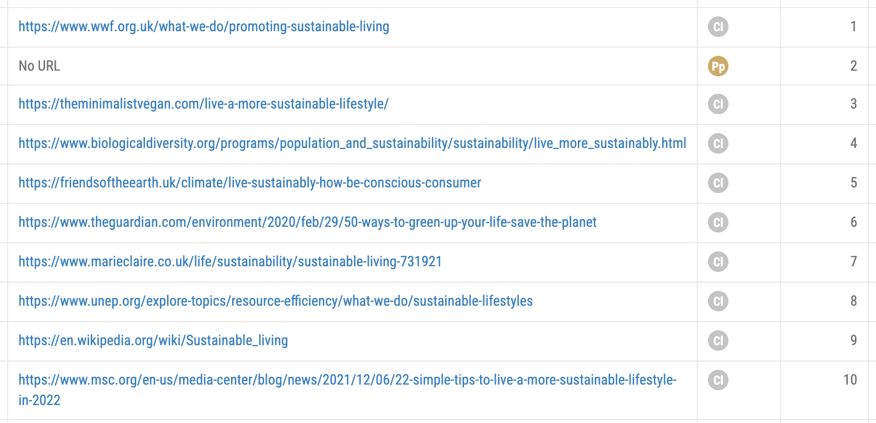
Organic SERP - January 2024 - search for: ‘Living sustainably‘
Page one - Google mobile
✅ People Also Ask ✅ Ten Blue Links
❌ Social ❌ Video ❌ images ❌ AIO

Slide 12
What’s changed in under a year?
In an attempt to rid the SERP of 40%+ of results that Google thinks are:
❌ Not helpful or not aligned with audience intent
❌ Commercially tainted
❌ Vanilla AI
❌ Low quality
❌ Written for algorithms rather than humans
❌ Otherwise seen as spam
Taking the same query today - Living sustainably…
Notes:
Andy - how much do you think that Algorithmic guidelines are influencing how content is written and optimised today

Slide 13
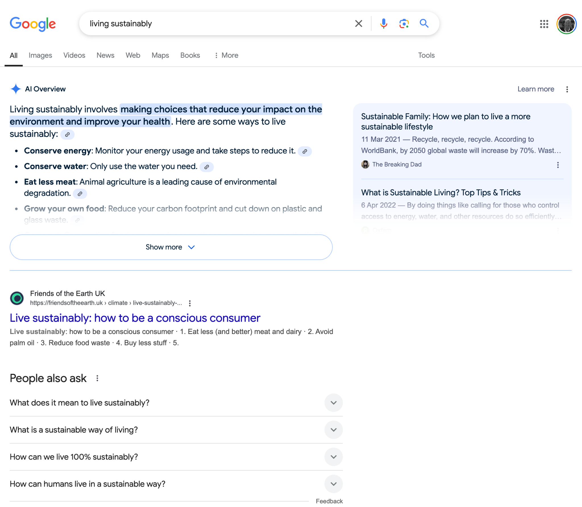
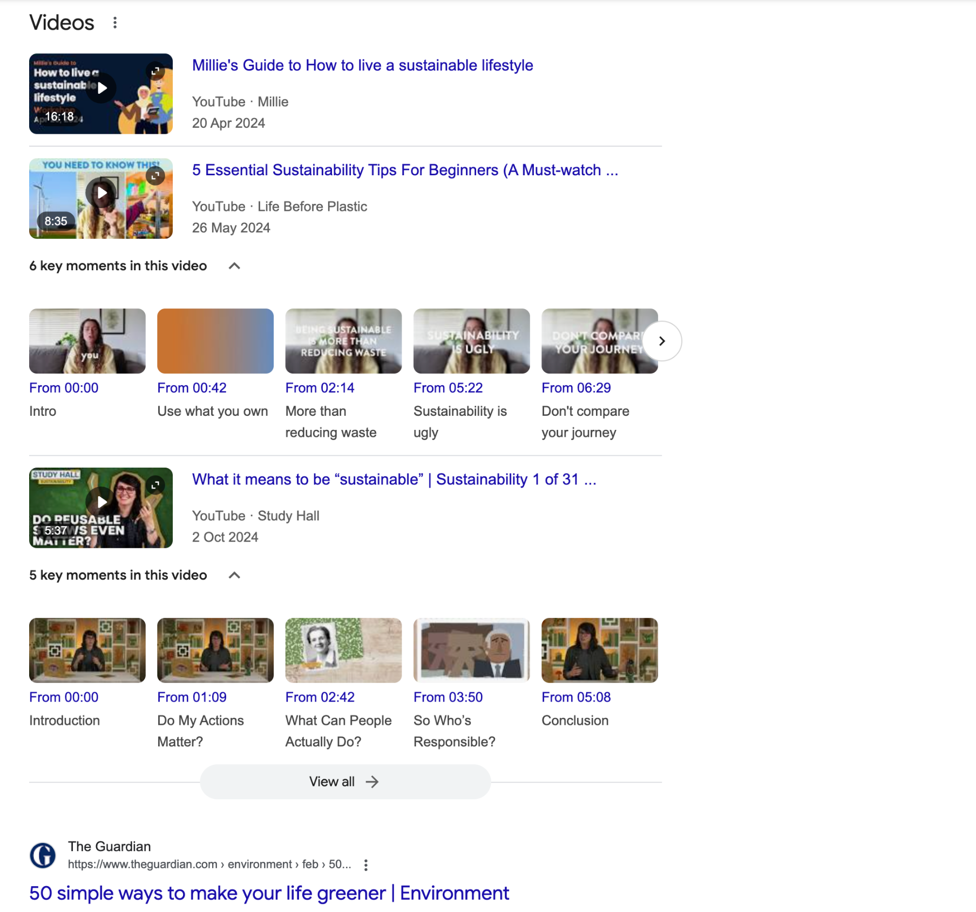
What page one of Google looks like today in 2025
AI Overview
First person, conversational content ✅ Quora ✅ Reddit ✅ 12+ Video touchpoints ✅ Images ✅ Forums
A conversational SERP fuelled and supported by social media/UGC
Notes:
Its unrecognizable
Andy - let’s get your take on the AIO and what it means for content creators
This is more that tha AIO - this is a SERP with more touchpoints, for more micro moments
Get 100 people in a room - they all have different ways of finding what they’re looking for

Slide 14
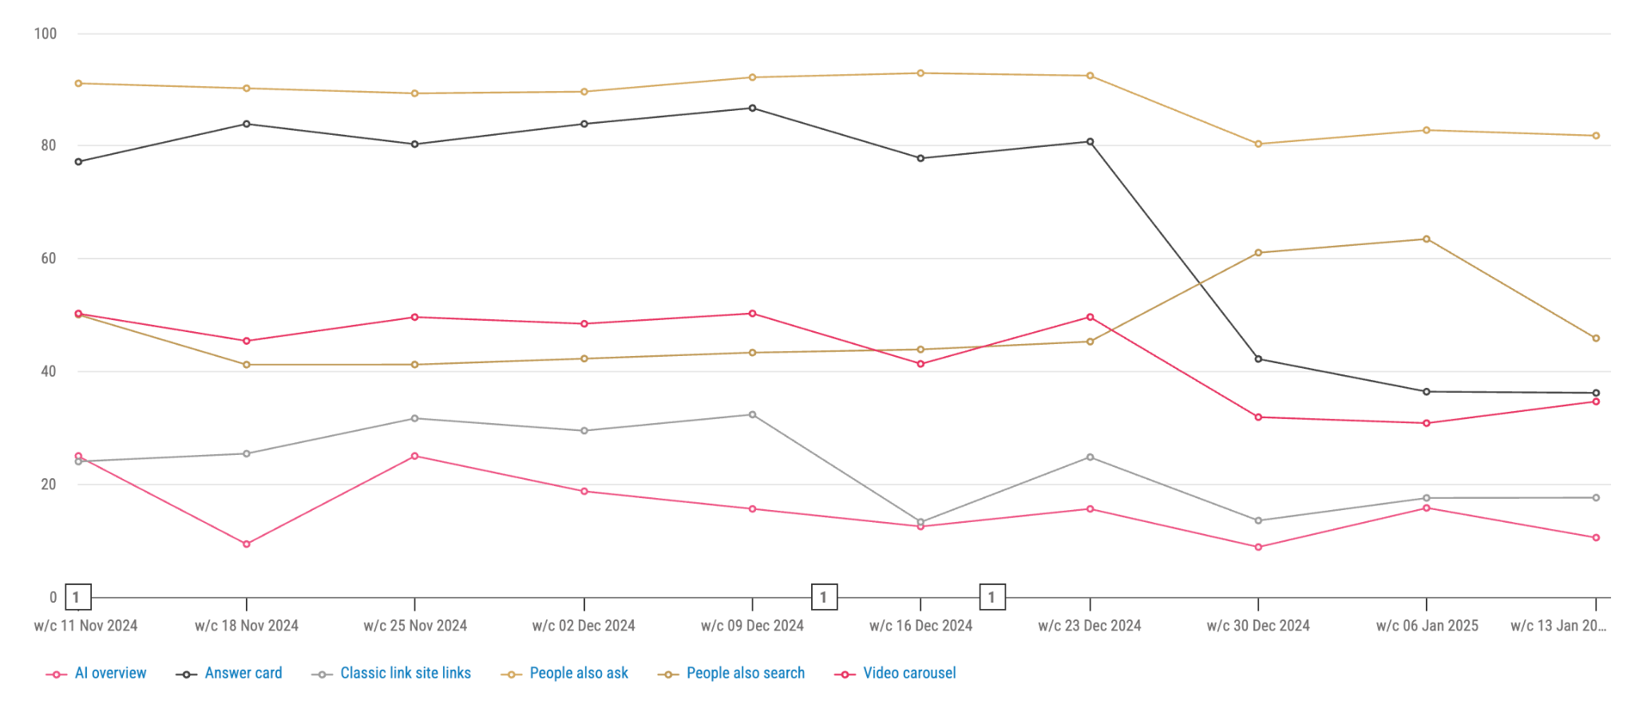
Visualising this new landscape
Notes:
So important to closely monitor SERP features as well as the AIO closely
as what you see varies by funnel stage as well as industry
Here we’re seeing a AIO presence hovering around 20+% (when its there - it dominates)

Slide 15
2
2025 Predictions

Slide 16
Macro thoughts
Notes:
For Andy to talk about the key tech players…
I would like to touch upon influence tech CEOs (I'm watching Bloomberg right now and Trump has just introduced Larry Ellison, Masayoshi Son and Sam Altman! Not a bad gig for day 2 even if it is a cheesefest) in the predictions section and how this influence will drive adoption and, unfortunately, the commercial interests that could lead to biased results influenced by advertisers.

Slide 17
A true Story
The problem with search
Notes:
It can be painful
Too much choice
Even when I search effectively - I can’t decide and I don’t trust anyone - brands / affiliates
The idea behind this story is threefold:
Brilliant way to sift through an unmanageable amount of information out there
The most powerful way to research a topic pulling from multiple sources including firsthand experience (Topical authority)
This is where search is headed - lifting the lid on incredible capability from Google

Slide 18
Notes:
An incredible tool for doing all the necessary topical research across multiple sources
Including Social, UGC etc
Complete with references and citations for every source used

Slide 19
I’m looking for:
✅ New oven
✅ Less than £500
✅ Bargain
✅ High quality
✅ Good/excellent reviews
✅ Enjoyable to use
✅ Standard sized
✅ UK only
Notes:
Getting a good result from a regular search won’t be easy - PAIN

Slide 20
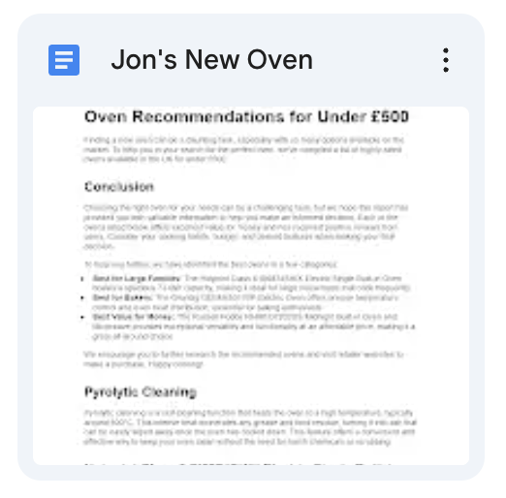
Research
Result
Present?
I’m looking for
A research plan
Research
Solution
Notes:
What GDR enables is this…
Slide generator plugin - boom!

Slide 21
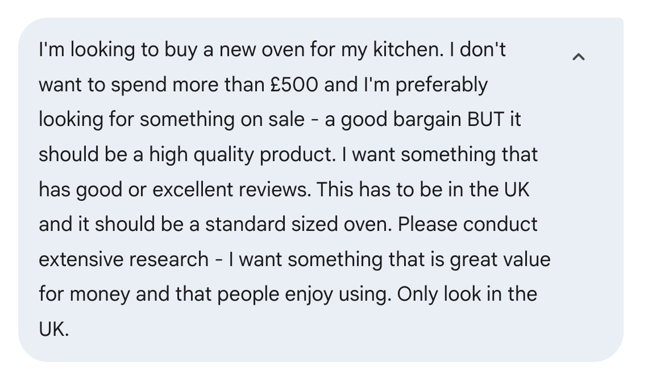
Notes:
For now - I build my query like this…
BUT in the future it’ll be a conversation
Google already sort of does this with AutoComplete AND Post query modifiers
Remember - every digital interaction that should be a conversation will become a conversation

Slide 22
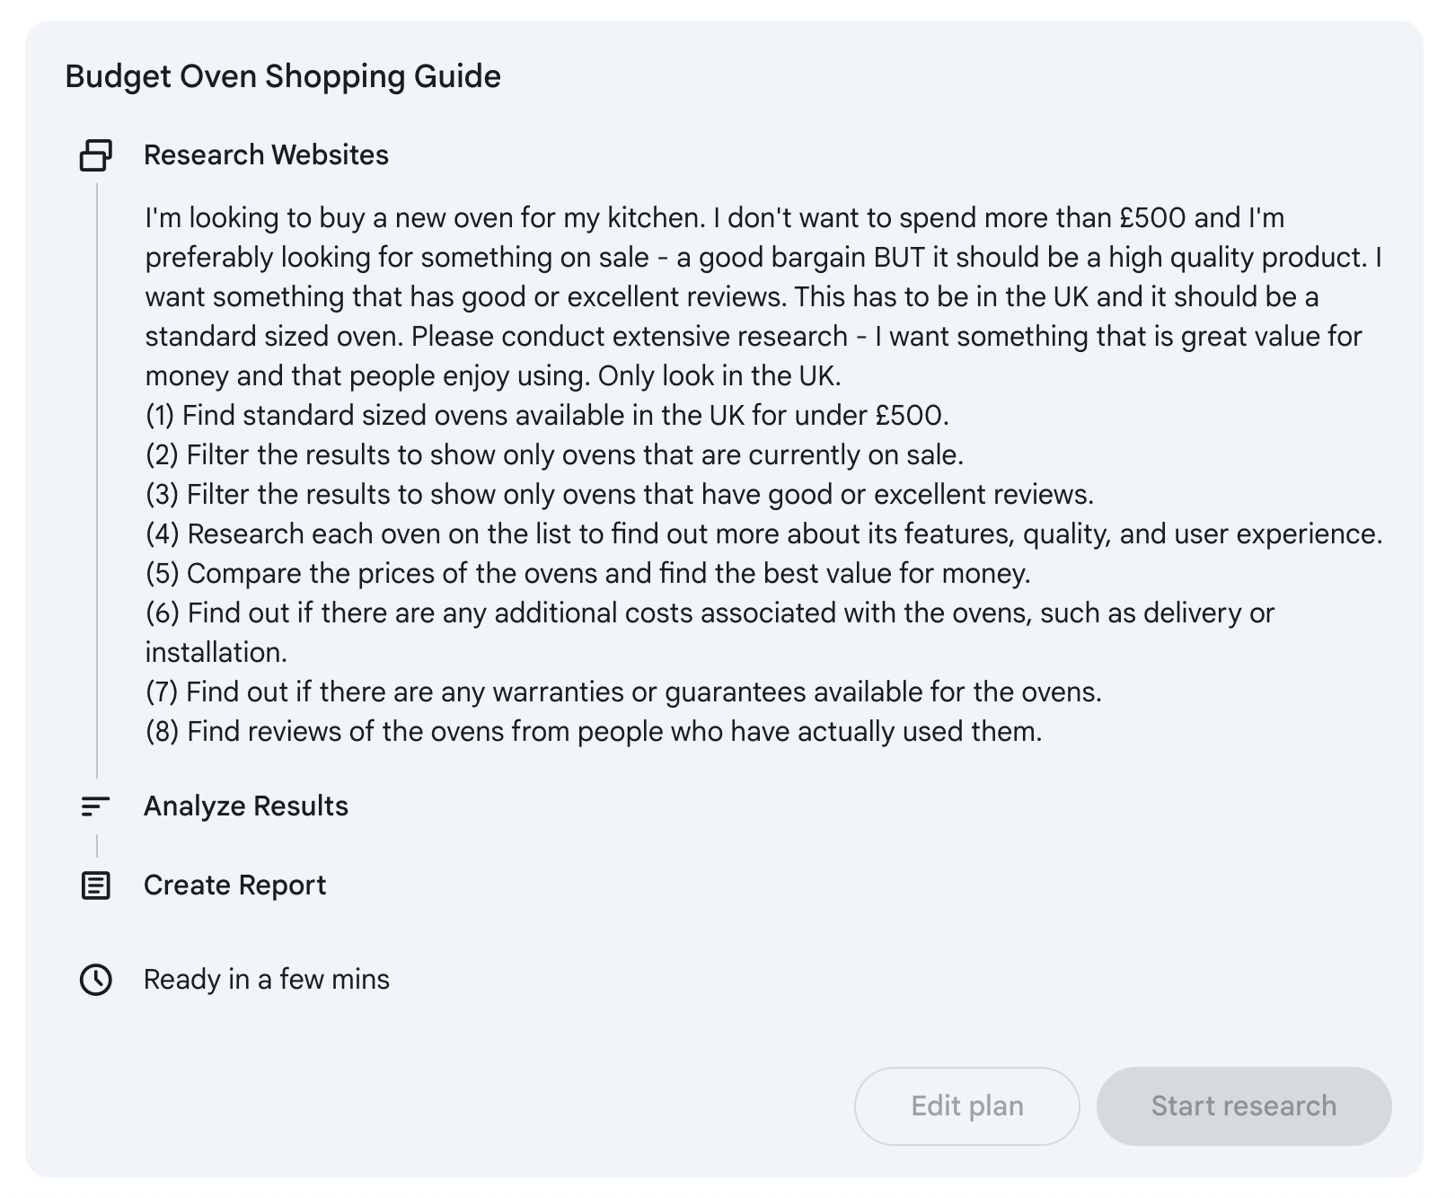
Find reviews of the ovens from people who have actually used them.
Find out if there are any warranties or guarantees available for the ovens.
Filter the results to show only ovens that have good or excellent reviews.
Notes:
Presented with a research plan you can edit
And click ‘Start Research’

Slide 23
Poll
How many websites did Gemini analyse
whilst doing this research?
Notes:
How many websites did Gemini analyse
whilst doing this research?
A. 23
B. 55
C. 185
Answer is C

Slide 24
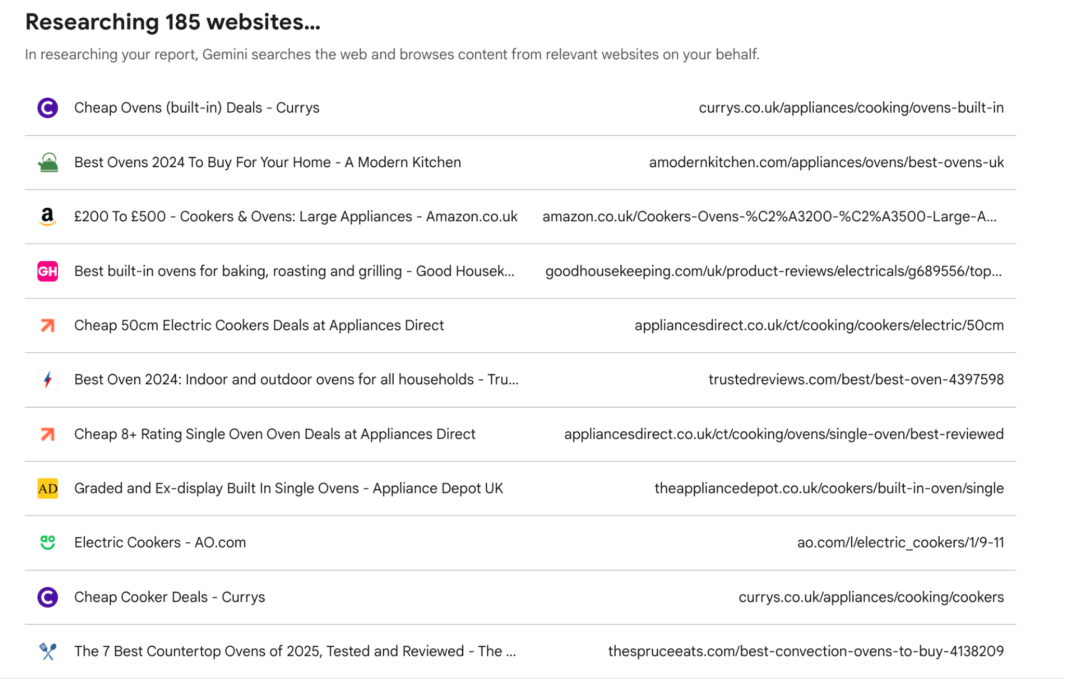
Notes:
It didn’t index 185 sites
It RESEARCHED what these sites, channels and PEOPLE had to say
Its like Gemini listened to what people had to say

Slide 25
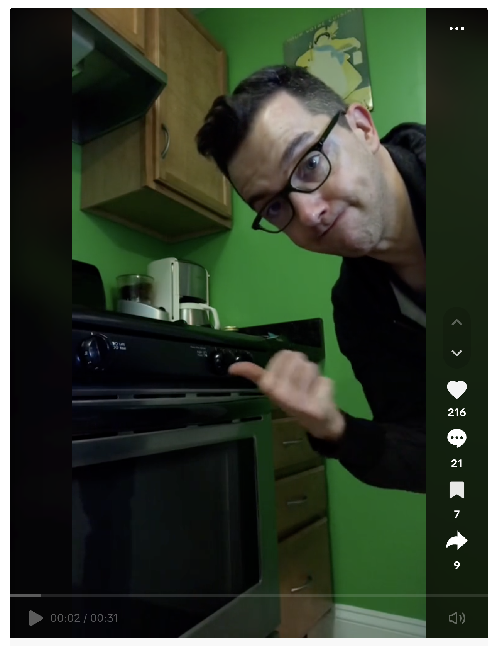
58 Videos
11 Videos
8 Conversations
Price filtered List & PDPs
And 100+ Brand PDPs, Articles, Reviews, etc.
Notes:
Sources included;;; As soon as I hear from real people who've actually bought/used the thing I need - my trust level goes up

Slide 26
Notes:
Plan took <60 seconds
The research took 8 minutes

Slide 27
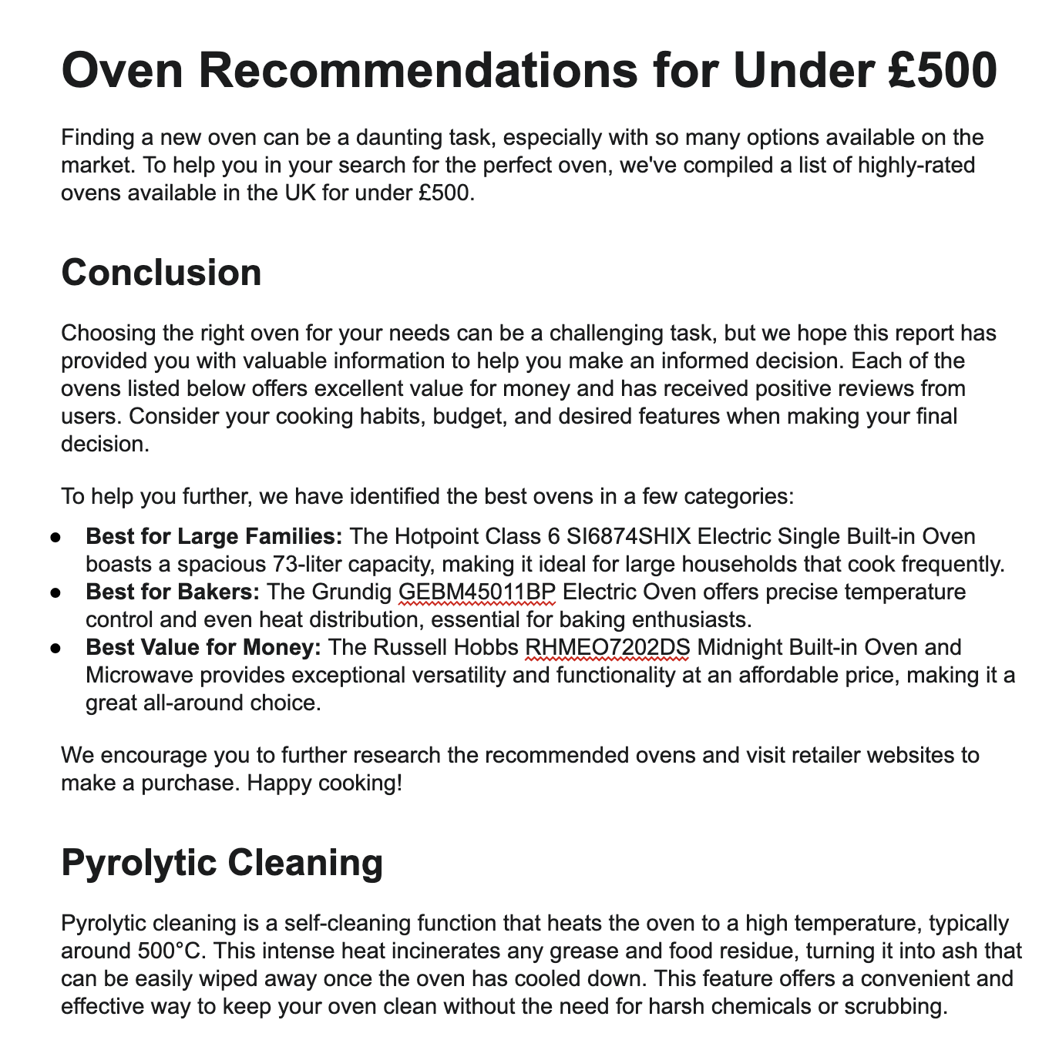
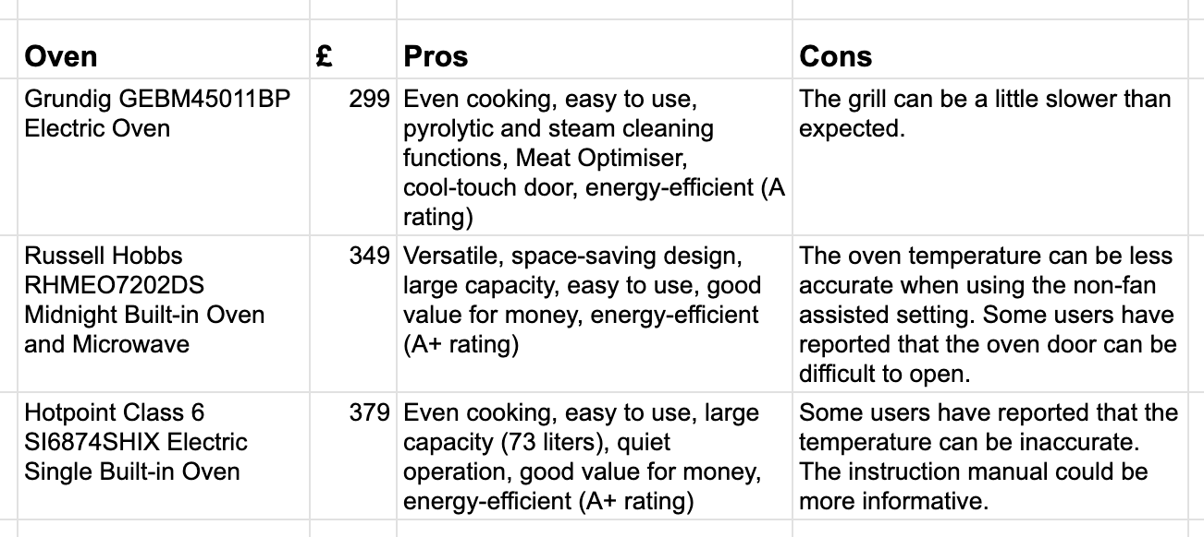
“Based on the listed prices, the Grundig GEBM45011BP Electric Oven appears to offer the best value for money, especially considering its features and positive user reviews.”
Notes:
14 Page report with
Recommendations and conclusions
Details of user experiences
Links to videos
Side by side comparisons
Pros and Cons

Slide 28
Gemini
AIO
Converged Conversational Search Experience
SSM
Notes:
A converged experience consisting of multiple mini surfaces in a single surface
A singularity

Slide 29
Remember these?
Are self cleaning ovens any good?
What should you look for when buying a new gas oven?
Do you always need a qualified electrician to fit a new oven?

Slide 30
70% already trust generative AI
search results
Notes:
Trust
Gartner predicts a significant drop in traditional search volume by 25% by 2026, with organic search traffic expected to decrease by over 50% as consumers embrace AI-powered search.
Additionally, 79% of consumers are expected to use AI-enhanced search within the next year and 70% already trust generative AI search results.

Slide 31
2.1
How should we approach AI & content?
Notes:
Does the answer matter providing it satisfies the user?
Should it matter whether a human or an AI produces a content experiences?
Andy poem example

Slide 32
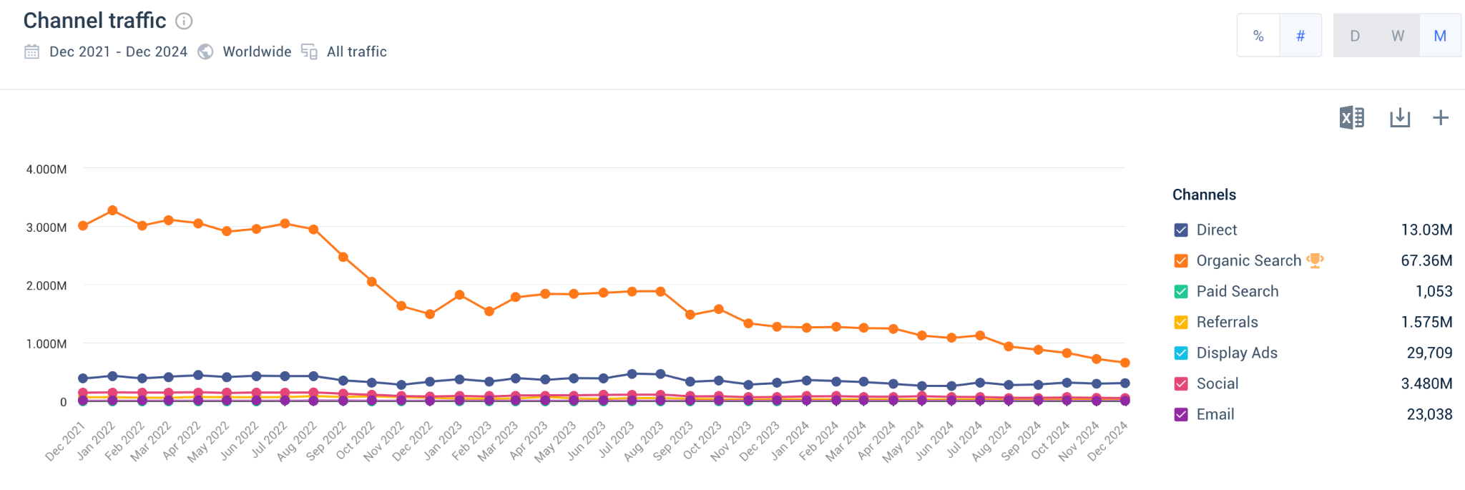
Be wary of going ‘all in’

Slide 33
2.2
How to navigate AI in your business

Slide 34
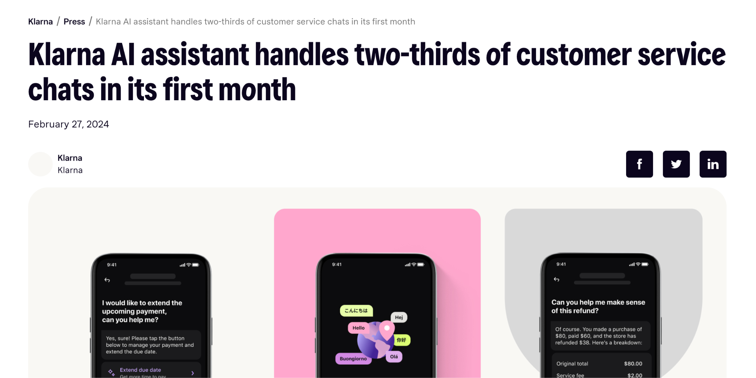
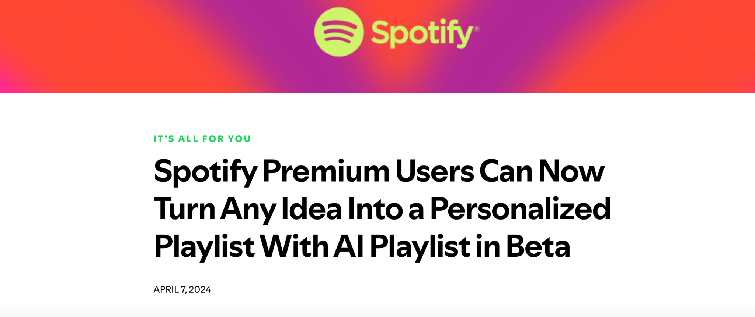
Brand utilising AI across operations & product

Slide 35
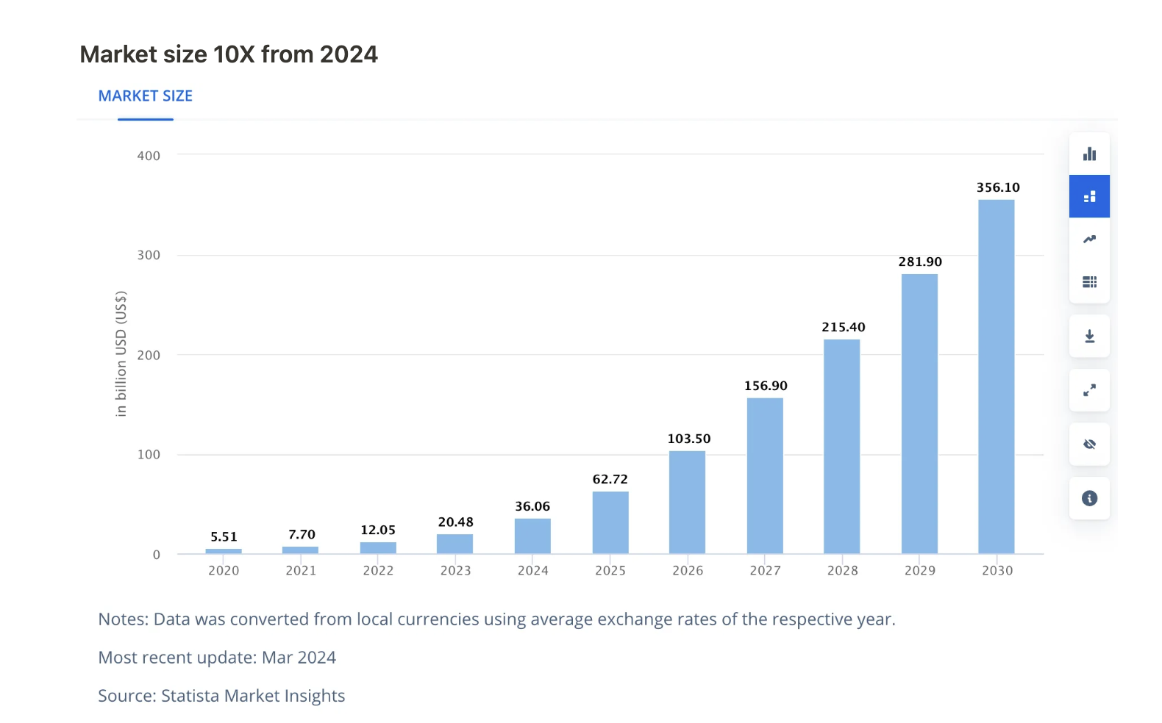
Market size expected to grow 10X by 2030
Notes:
Ask Andy - how you keep up!

Slide 36
How do you keep up?
Notes:
In 2005 Google started to allow more than ten words in a query

Slide 37
Scheduled tasks in ChatGPT
Create tasks to run at a specific time/day
Execute whether I’m online of off
Push notifications when I need them
Notes:
A step closer to a personal assistant
The problems with ‘news’ newsletters is that I never read them

Slide 38
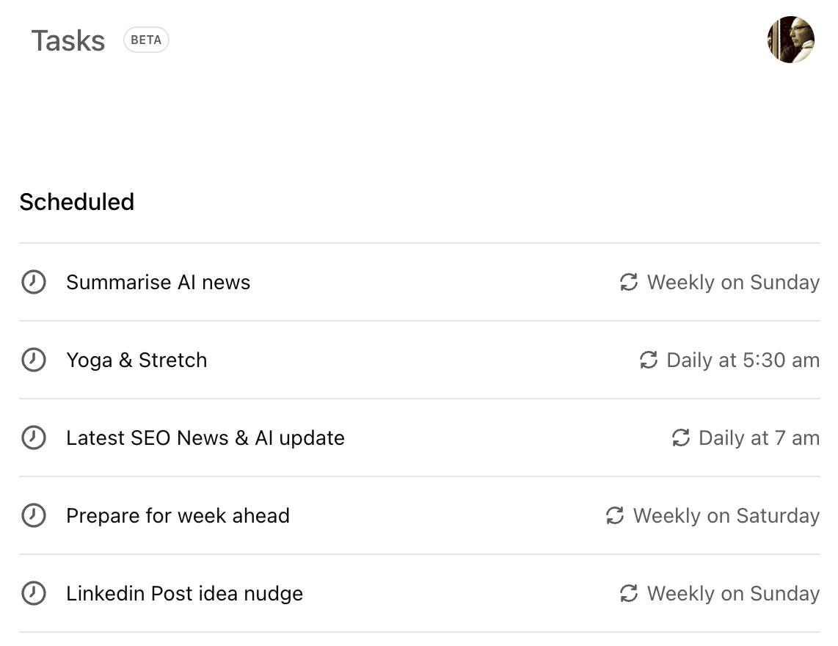
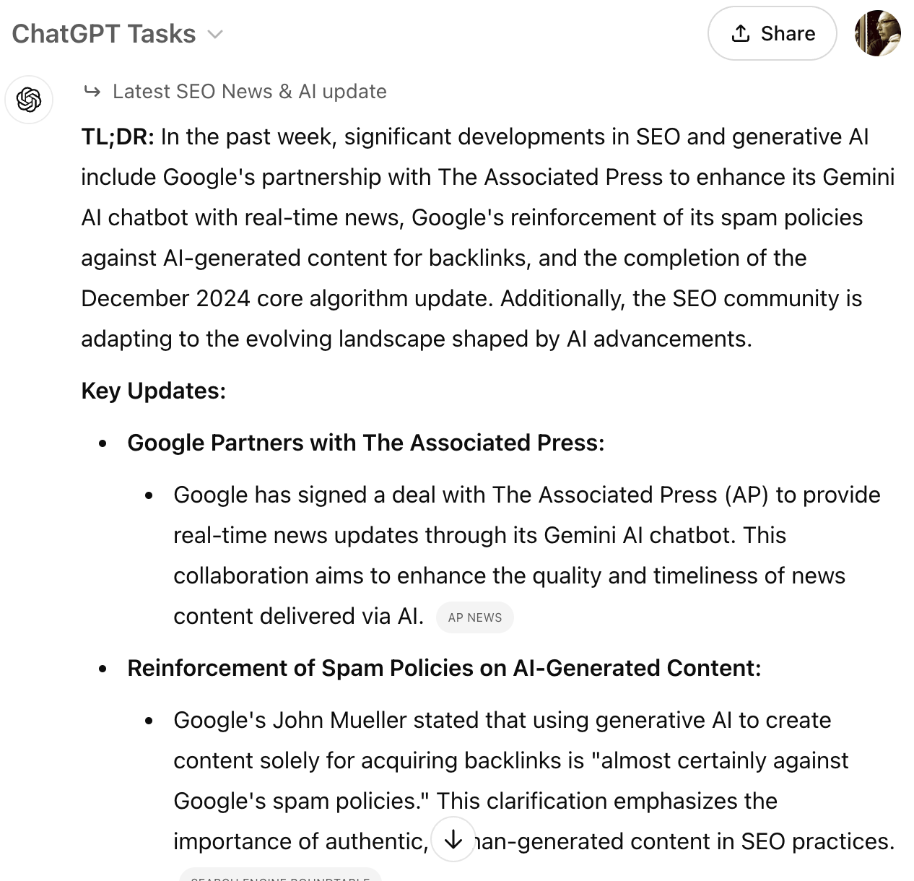
Scheduled tasks in ChatGPT
Notes:
COMING UP OpenAI is developing new technology aimed at enabling AI to control computer interfaces.

Slide 39
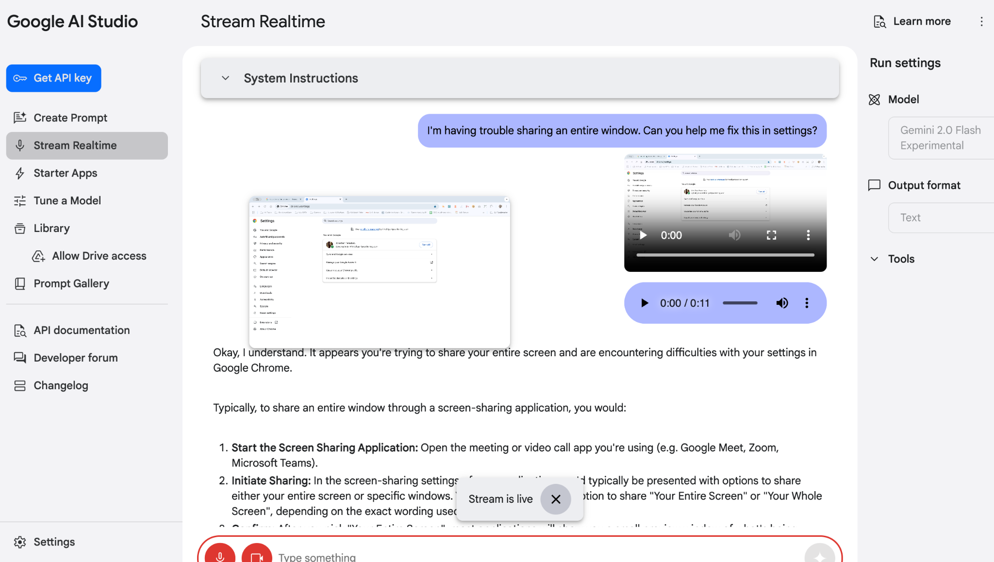
Google AI Studio
Notes:
Visually supported conversations
Help me figure out what I’m looking at here…
Talk me through it!
Chrome settings to understand why screen rather than tab sharing doesn’t work sometimes
Understand how a piece of software works

Slide 40
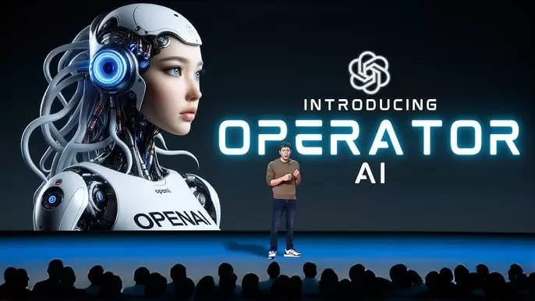
Operator
Notes:
OpenAI is developing new technology "Operator" as soon as THIS month - January 2025
an AI tool that can take control of your PC and perform actions on your behalf
it's a direct response to Anthropic's similar computer control product, and part of a broader race toward autonomous AI agents.
The real value isn't in who builds the best computer-controlling AI –
it's in who creates the strongest ecosystem lock-in.
If OpenAI's Operator succeeds, it becomes the intelligence layer sitting atop all software interaction. That's not just a product; it's an ecosystem play.

Slide 41
4
Must-have AI tools for 2025

Slide 42
Must-have AI Tools & Technology for 2025
Fireflies
Canva Magic Studio
Integrated AI wizards (i.e. CMS)
Personal (GPT) Assistants & bookmarklets
Pi Optimise Now
Notes:
Aside from what’s already mentioned
If I repeat a task and its gonna happen again - I build a GPT
Blog article outliner
SERP analyser
SERP scraper
Keyword builders (by vertical)
Conversational keyword builder
Don’t forget your custom instructions - so powerful!!!

Slide 43
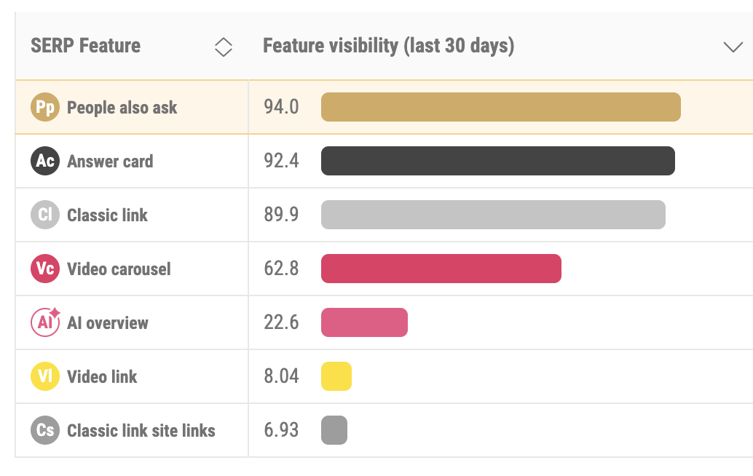
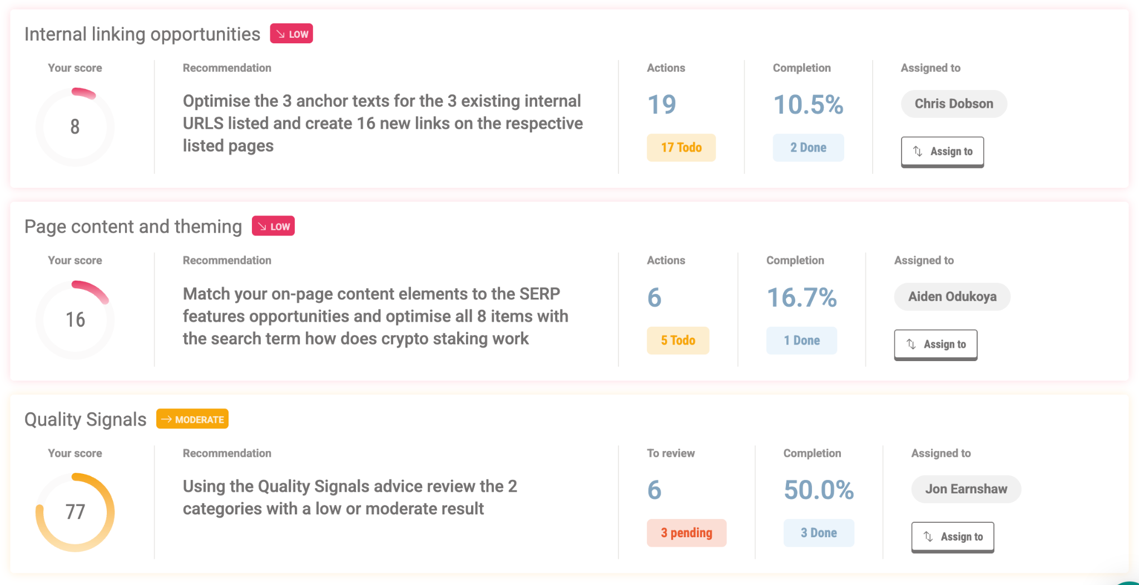
Pi Optimise Now
Notes:
Analyses the SERP
Does all the heavy lifting for you
Optimisation in context - SERP, Algos, Competitors, Your ecosystem

Slide 44
Takeaways
You can’t know everything - be curious
Horizontally integrate yourself in your business
Understand your company’s AI strategy
Look at how you can automate manual processes
Always remember the CX is at the heart of it

Slide 45
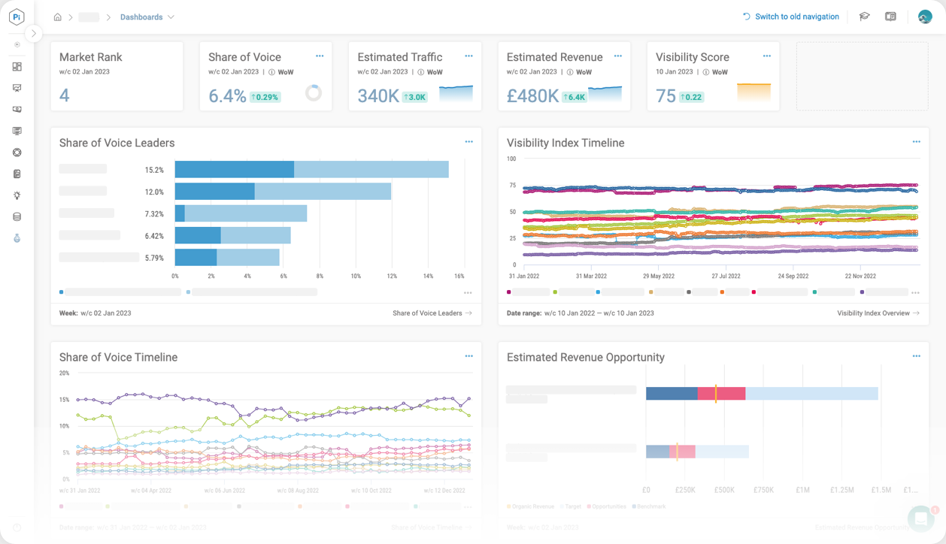
Would you like a demo of Pi Datametrics?
Combining software, data and people, our SEO platform helps eCommerce brands increase traffic, improve brand visibility and boost ROI.
Notes:
Just before we go to the Q&A - who would like to demo Pi Datametrics?
Yes
No
I’m already a customer

Slide 46
Q&A
Notes:
Open the floor to questions from the audience
https://chatgpt.com/g/g-K3gLIMs5F-pi-sge-conversational-extension-builder
If anyone has questions, put them in the questions box at the side

